Slide 1
WELCOME
"The blood is red gold in time of saving a life.”

Slide 2
Project On Blood Bank Implementation System
Prepared By
Ashwini Gujar (AB+)
Sneha Surendran(O+)
Chaitali Chaudhari(O+)
Guided By
Santosh Mali Sir

Slide 3
Contents
Introduction
Aims & Objectives
Modules
Technical Specification
Conclusion

Slide 4
Introduction
The main aim of this project is to save the lives of people by providing blood.
This project is developed by four perspectives i.e. Doner, blood bank, volunteers and patient.
This application reduces the time to a greater extent that is searching for the required blood through blood banks and hospitals.
Thus this application provides the required information in less time and also helps in quicker decision making.

Slide 5
Aims & Objectives
To bridge the gap between blood banks, hospitals, volunteer donors and needy people, through this system.
To facilitate the search process for needy people and make it easier than before.

Slide 6
Modules
Home
Doner
Recipent
Guidelines
Volunteer
Admin

Slide 7
Technical Specification
HTML
CSS
JavaScript
Core Java
IDE
Eclipse

Slide 8
Home
Home page is developed by Ashwini Gujar.
A Home Page is the main web page of a website.

Slide 9
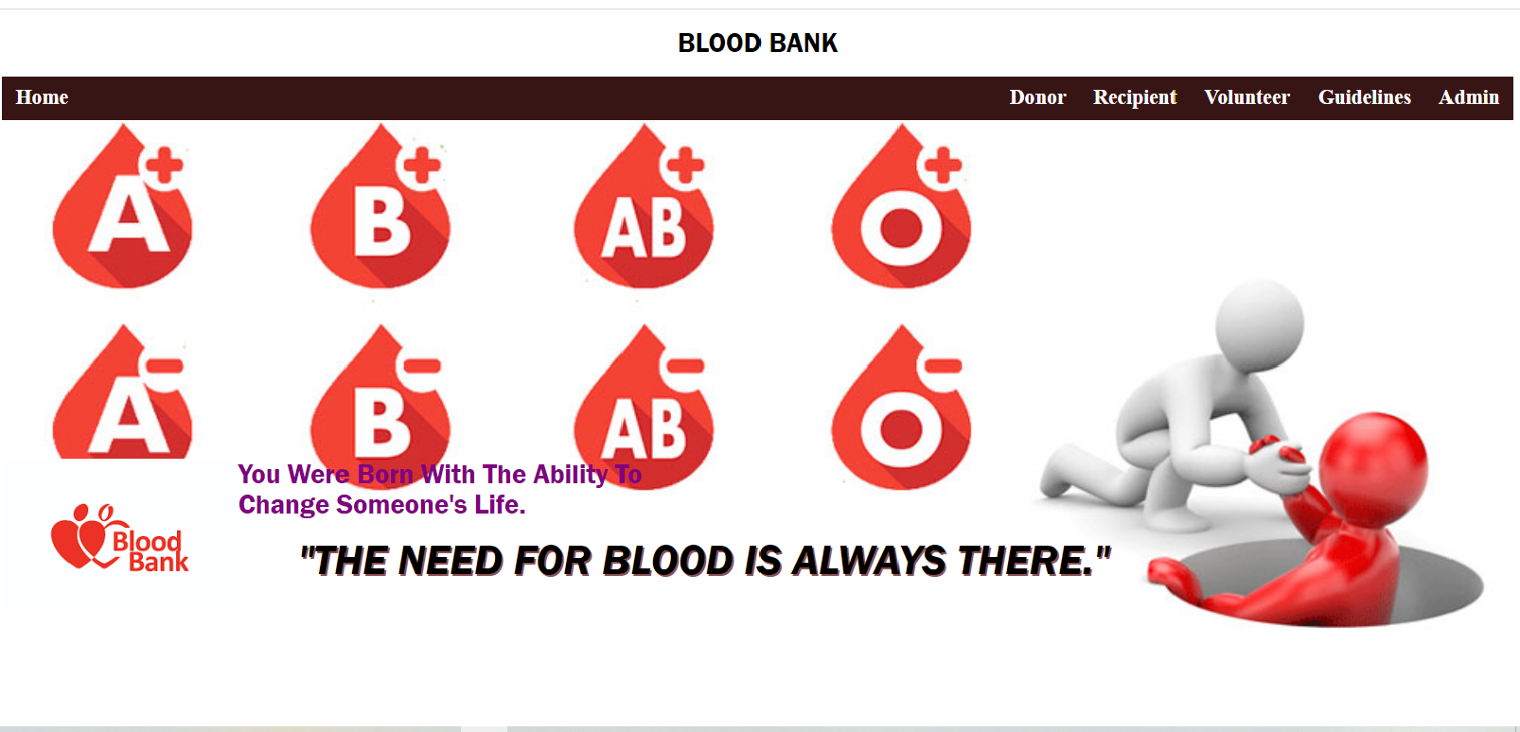
Home Page

Slide 10
Donor
Donor page is developed by Sneha Surendran.
People who are having the thought of donating blood gets registered giving their total details.

Slide 11
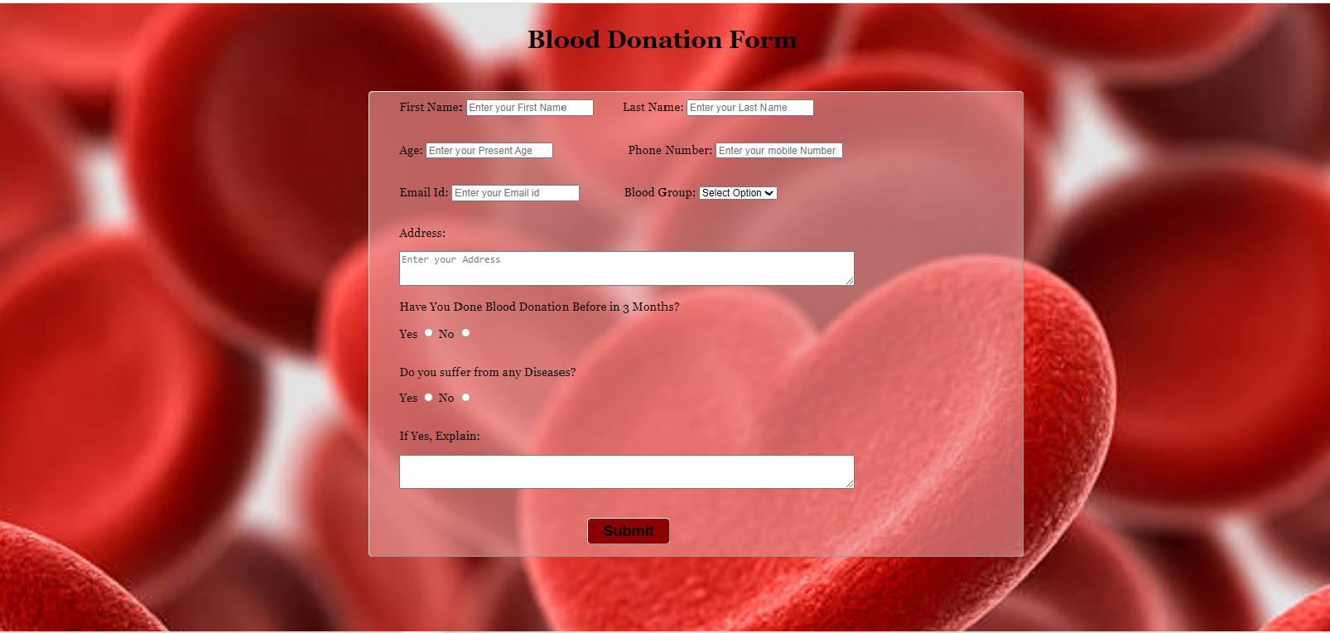
Donor Page

Slide 12
Recipient
Recipient page is developed by Chaitali Chaudhari.
In these a person can register his details and can search the availability of the blood group he/she required.

Slide 13
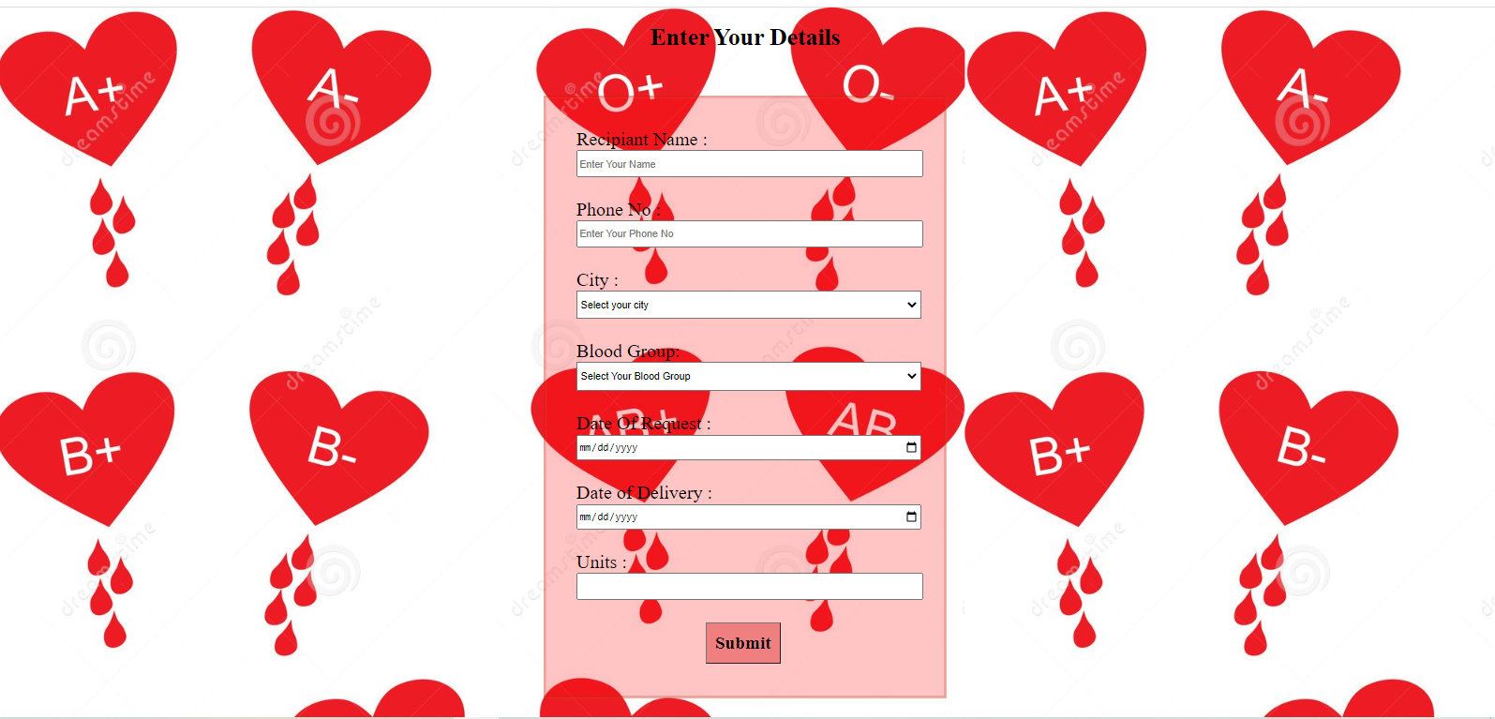
Recipient Page

Slide 14
Volunteer
Volunteer page is developed by Sneha Surendran.
Those person who are willing to volunteer the campaign can register through the volunteer page provided by us so if required they will be contacted in their registered phone number or Mail id.

Slide 15
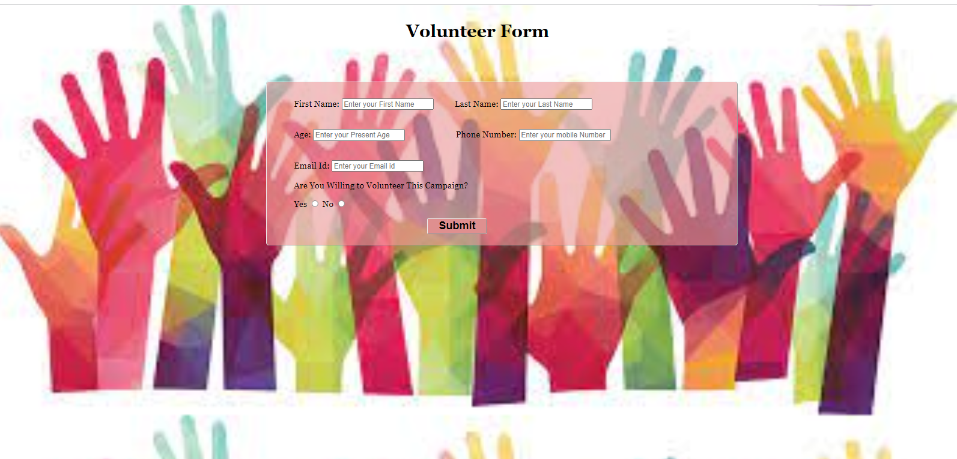
Volunteer Page

Slide 16
Guidelines
Guidelines page is developed by Chaitali Chaudhari.
Guidelines are given just to provide an awareness to the donors about the Do’s and Don’ts of blood donation .

Slide 17
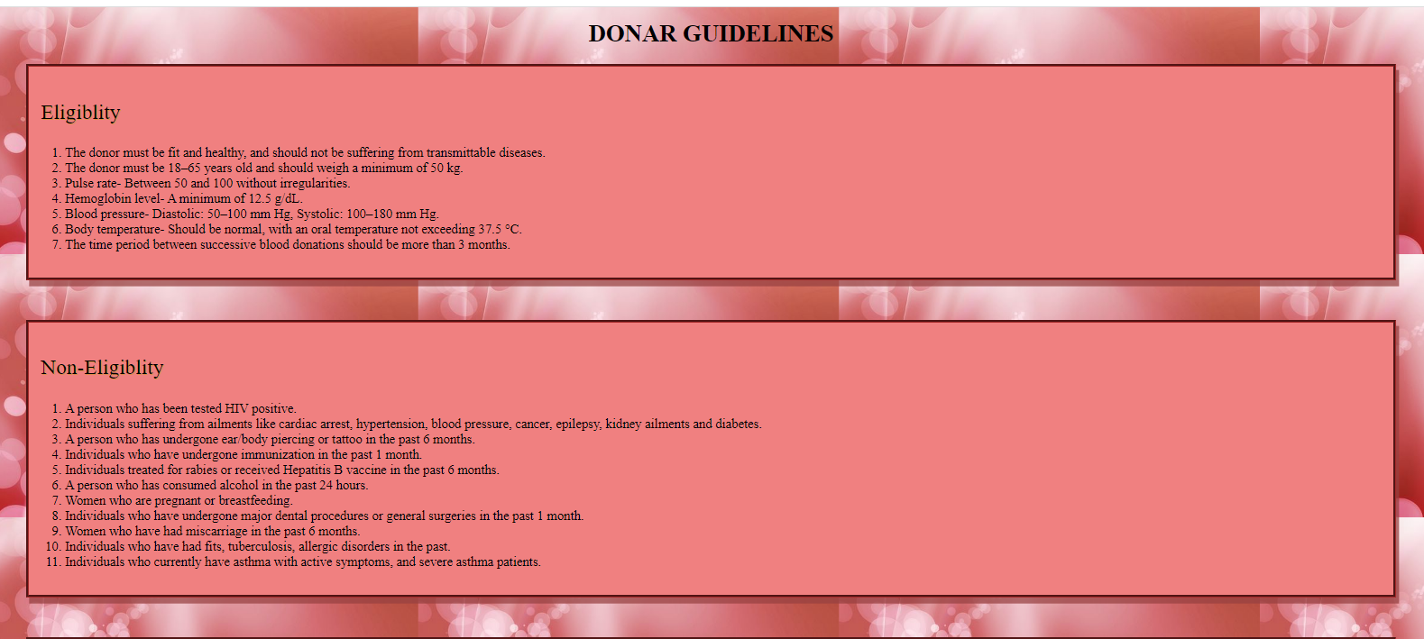

Guidelines Page

Slide 18
Admin
Admin page is developed by Ashwini Gujar.
Once an account is created by a user then he/she can login through the admin page for further procedures.

Slide 19
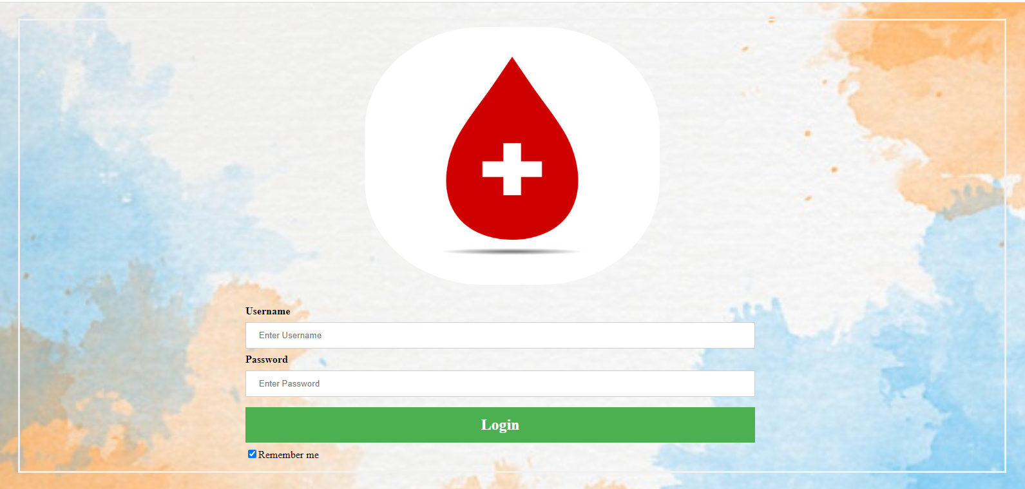
Admin Page

Slide 20
Conclusion
Blood Bank Management System is a system that can assists the information of blood bag during its handling in the blood bank.
With this system, the user of this system can key in the result of blood test that has been conducted to each of the blood bag received by the blood bank.

Slide 21
Thank You..
“You can share messages, why not blood?”

